Slide 1
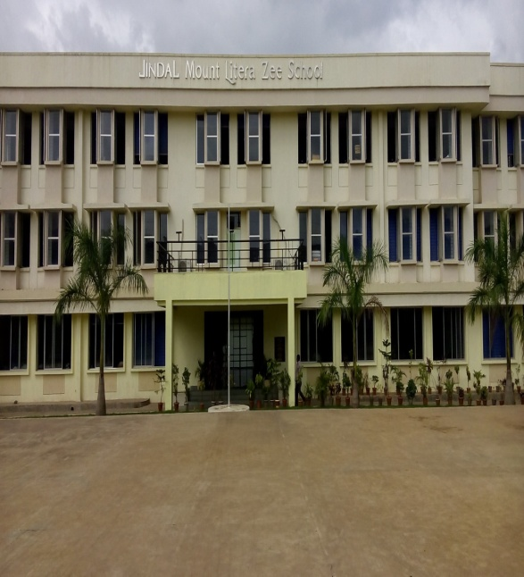

Slide 2
Welcome Dear Parents for Academic Year 2023-24
Pre-Primary Section

Slide 3
The Mission/Vision of JMLZS
Mount Litera Zee School will provide a complete and unique educational experience for the child, preparing him/her for a successful life in the contemporary society.
The vision of Jindal Mount Litera Zee School envisages:
To create an excellent educational institution synthesizing the human values with the highest quality of teaching–learning using modern technology-driven tools for preparing a well-rounded personality for our society.
To make children aware of the significance of an eco-friendly environment. To nurture the unique potential in each child.
3

Slide 4
Our Philosophy
At the core of every thing we do at Mount Litera Zee School is one simple principle.
“What’s Right For the Child” (WRFC).
Through that mantra we filter all our decisions and actions.
WRFC helps us keep the child at the center of everything we do and ensures single-minded devotion to his/her growth and development.
JINDAL MOUNT LITERA ZEE SCHOOL
4

Slide 5
Introduction to the
Management Committee
JINDAL MOUNT LITERA ZEE SCHOOL
5

Slide 6
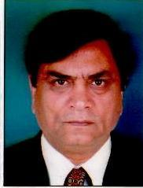
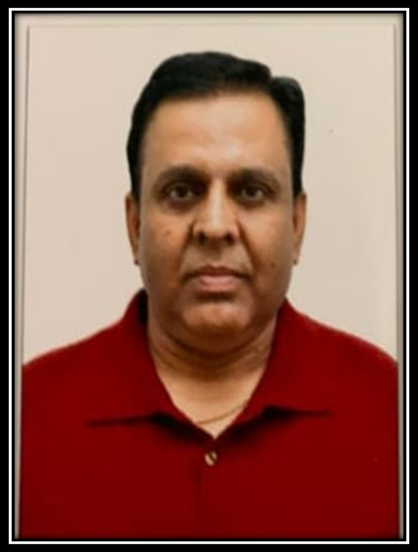
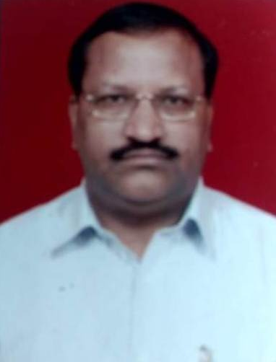
School Management Committee Members
Chairman
Mr. Vijay Kaushik
Member
Mr. Sanjeev Banarjee
Member
Mr. Shiv kumar Singhal
JINDAL MOUNT LITERA ZEE SCHOOL
6

Slide 7
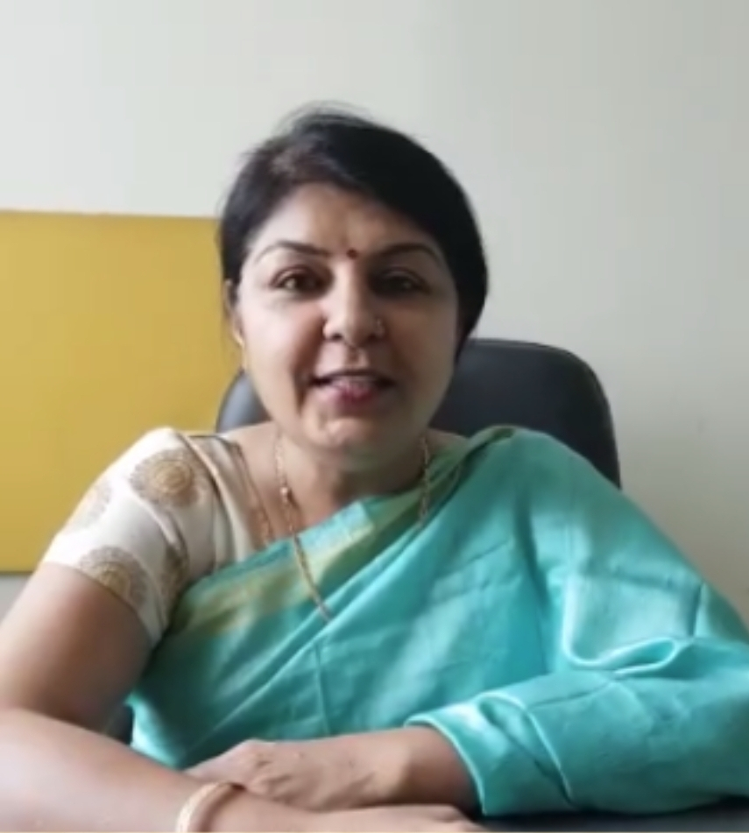
OUR MENTOR
REGIONAL SCHOOL DIRECTOR
Ms. Neeru Nayyer
neeru.nayyer@zeelearn.com
7

Slide 8
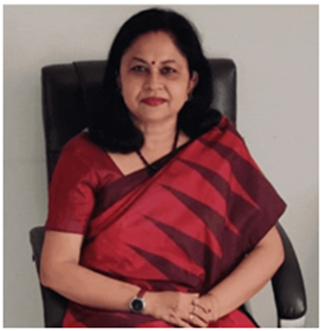
PRINCIPAL
Ms. Lily Roy
lily.roy@jmlzsnagothane.in
8

Slide 9
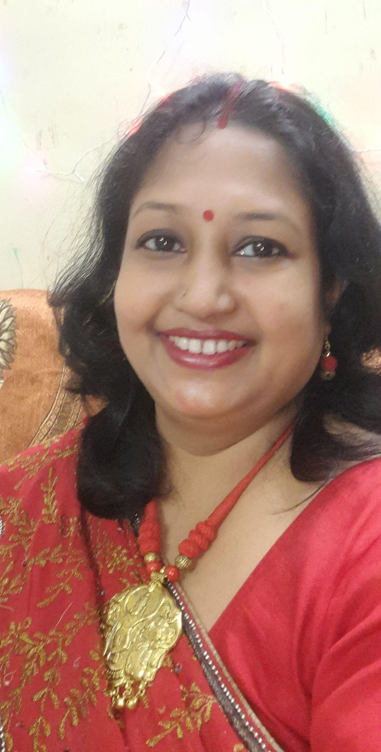
CO-ORDINATOR
Pre-primary
Ms. Dwiprova Sarkar
dwiprova.sarkar@jmlzsnagothane.in
9

Slide 10
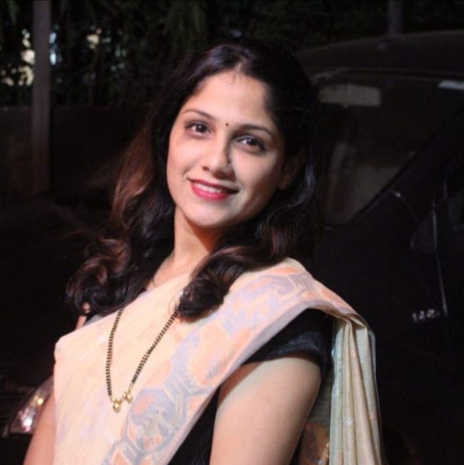
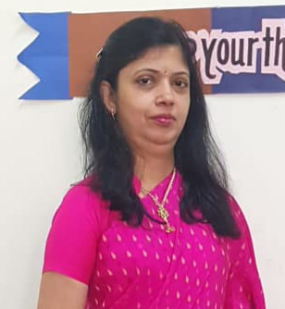
CO-ORDINATOR
Primary (Grade 1 -2)
Primary (Grade 3 - 5)
Ms. Amruta Shinde
amruta.shinde@jmlzsnagothane.in
Ms. Rashmi Saxena
rashmi.saxena@jmlzsnagothane.in
9

Slide 11
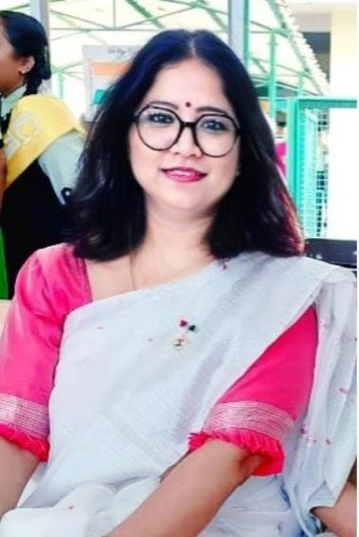
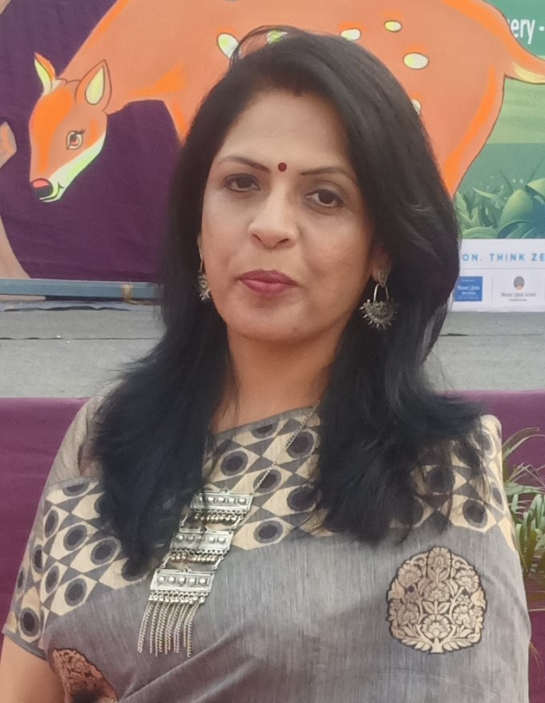
CO-ORDINATOR
Secondary ( Grade 6 - 8)
Sr. Secondary ( Grade 9 - 12)
Ms. Radha Mishra
radha.mishra@jmlzsnagothane.in
Ms. Manisha Dubey
manisha.dubey@jmlzsnagothane.in
10

Slide 12
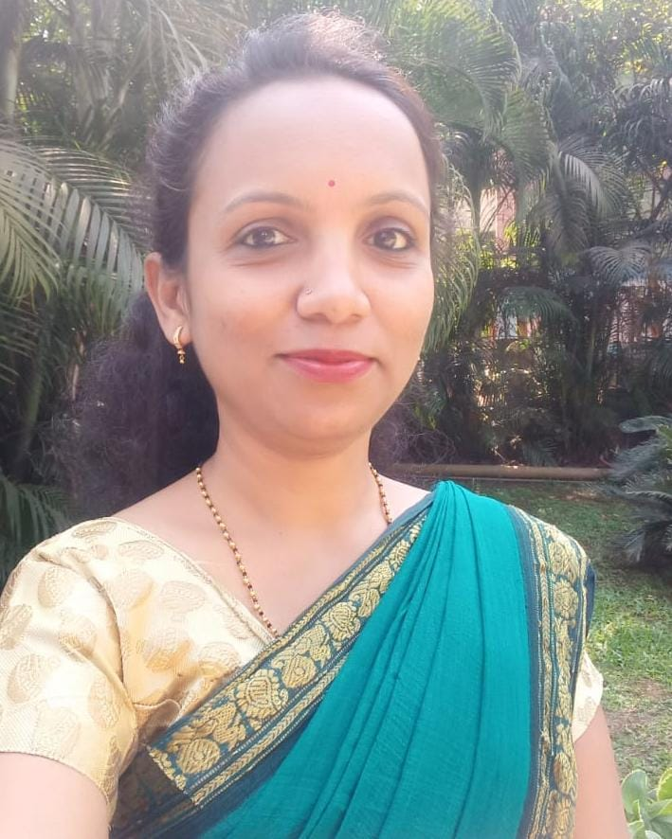
PRE PRIMARY STAFF
MS. KAVYA MAMDYAL
NURSERY - A
B.A, M.S.W, B. ED
MS. POONAM JAWAKE
NURSERY – B
T.Y.B.COM
DIPLOMA IN PHONICS
PURSUING E.C.CED
NURSERY

Slide 13
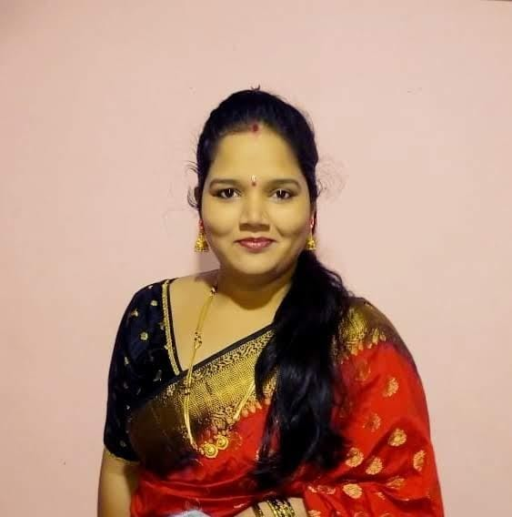
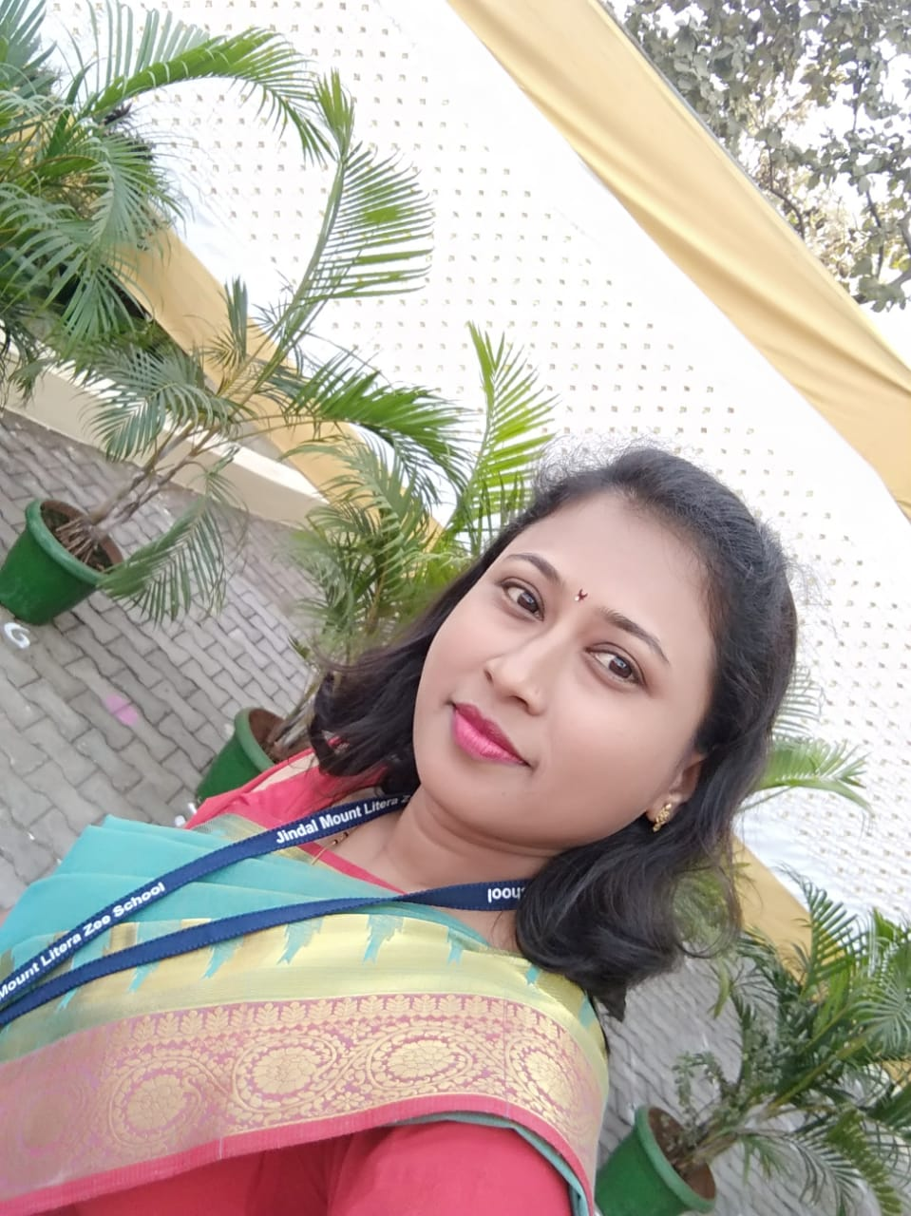
PRE PRIMARY STAFF
MS. JYOTI HIREMATH
JR.KG A
M. SC (STATISTICS)
MS. VIJAYANTA BHAROSE
JR.KG - B
B.E (ELECTRICAL)
E.C.CED
JR.KG

Slide 14
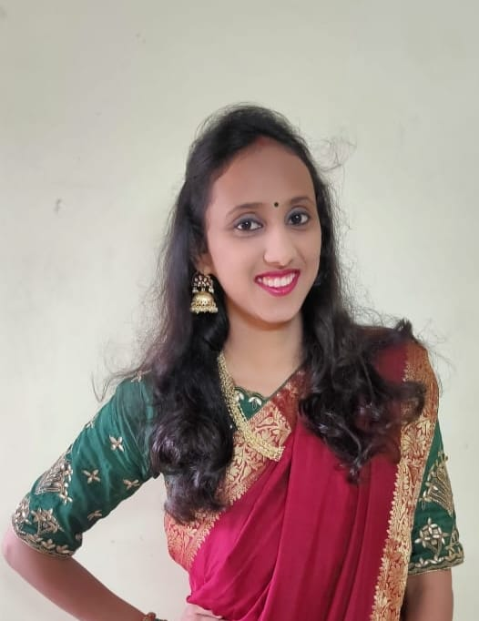
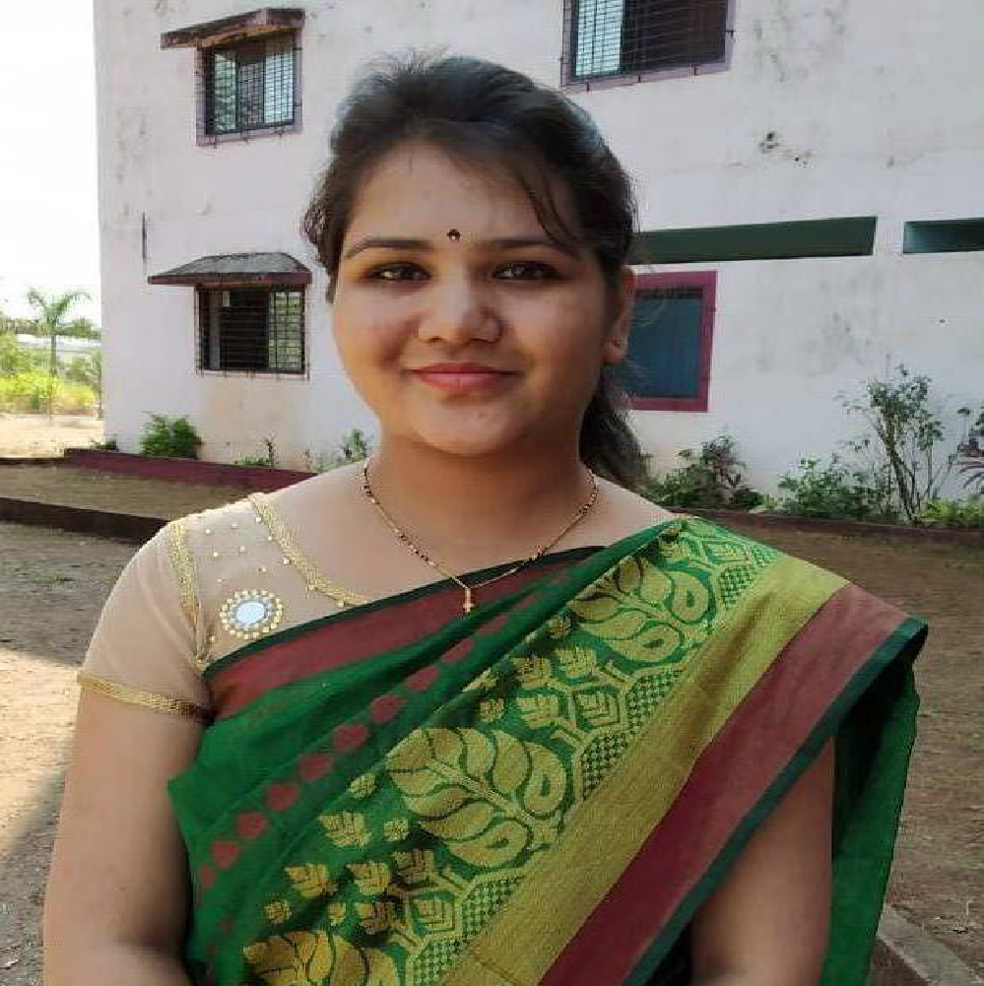
MS. POOJA AGRAWAL
SR.KG A
M.COM
MS. DWIPROVA SARKAR
SR.KG B
M.A ( ENGLISH)
E.C.CED
MS. POOJA GURAV
DIPLOMA IN IT
PURSUING E.C.CED
SR.KG

Slide 15
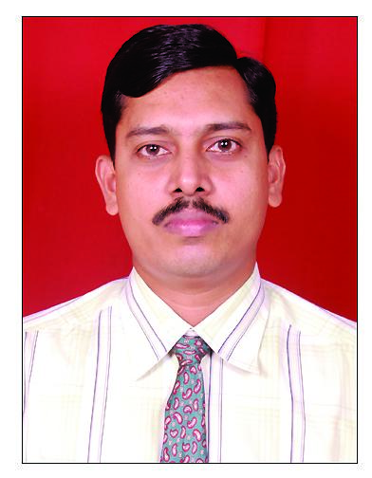
Admin Head
Mr. Sunil Nair
sunil.nair@jmlzsnagothane.in
Contact no: 9867254986
15

Slide 16
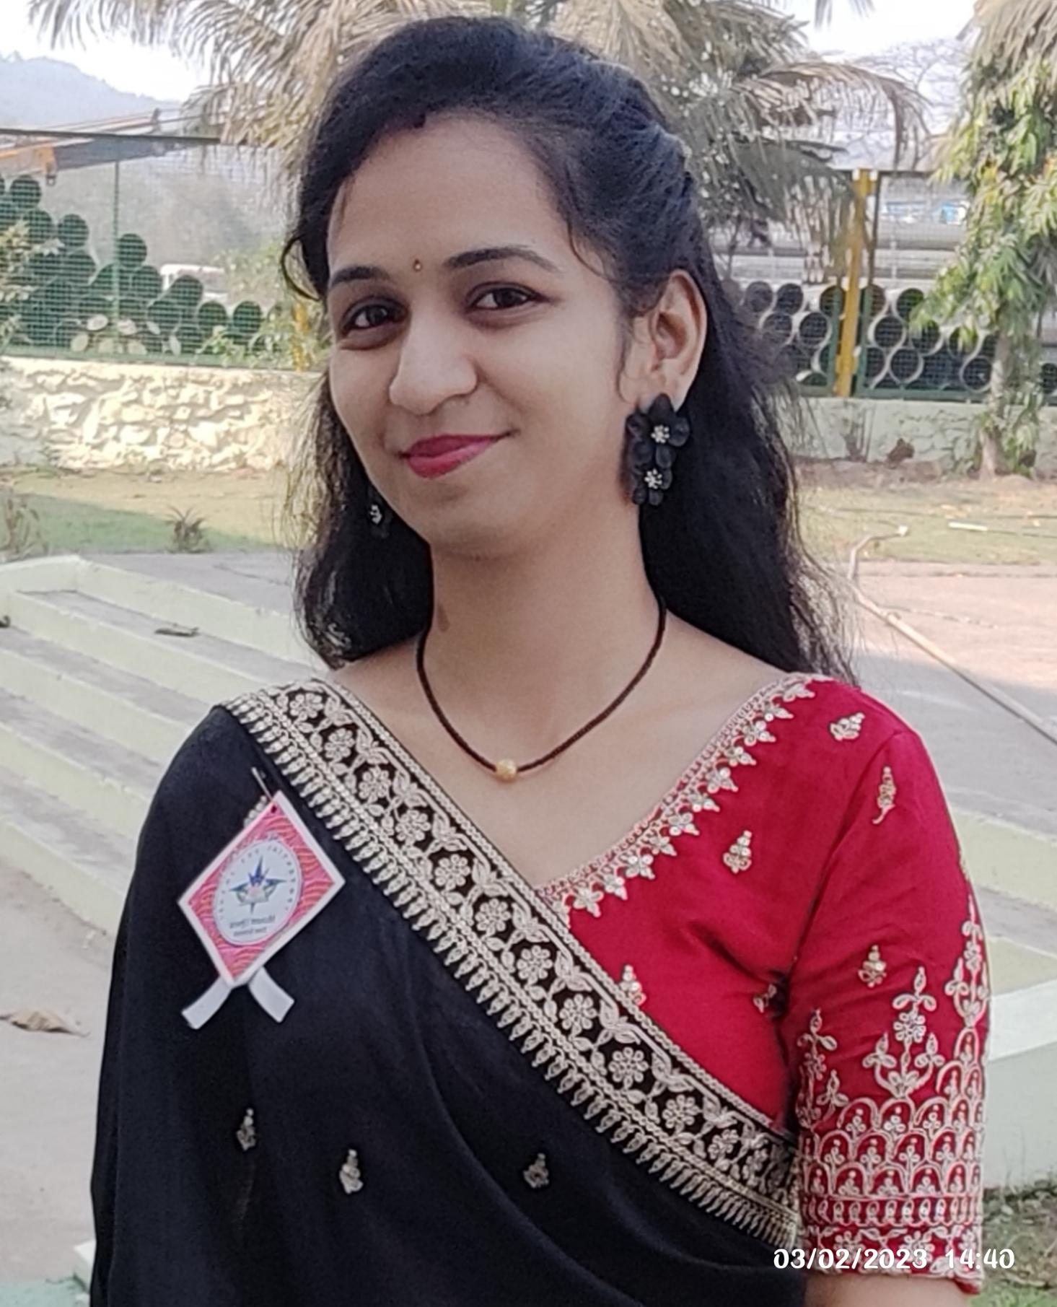
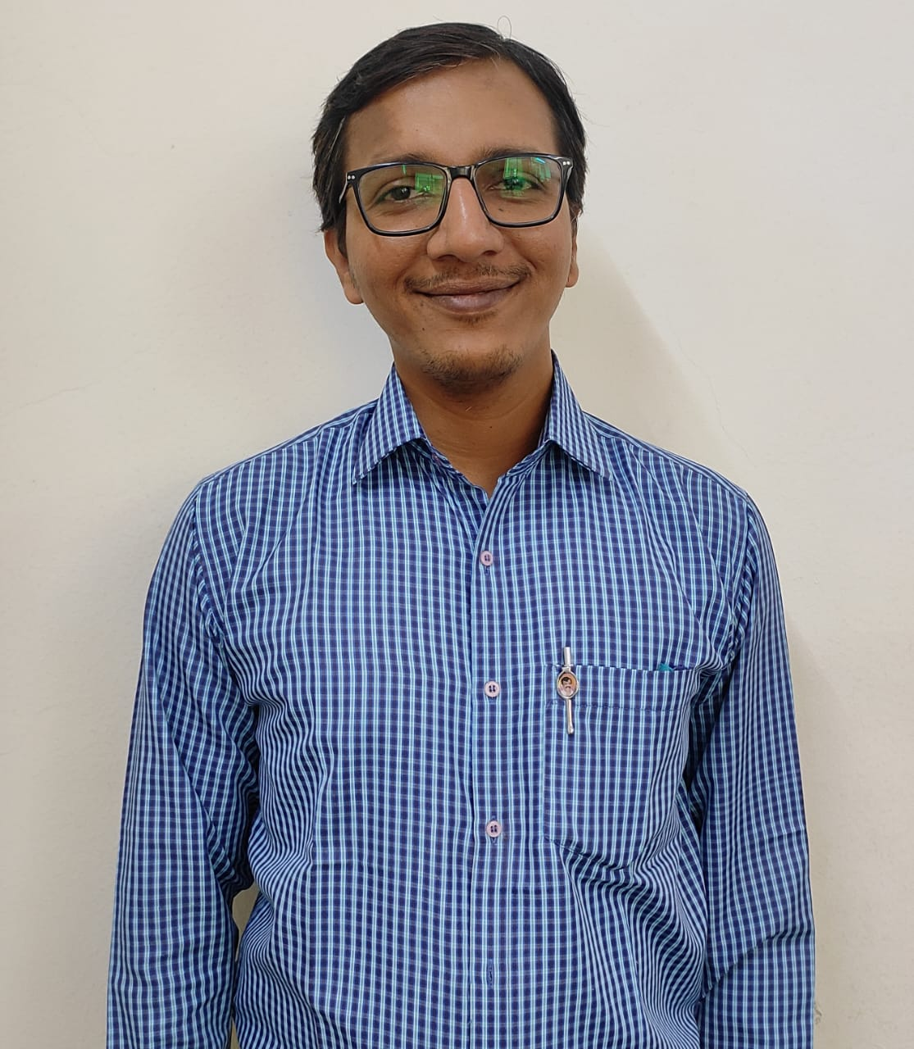
OUR ADMIN TEAM
Ms. Prajakta Bamane
prajakta.bamane@jmlzsnagothane.in
Mr. Paresh Patil
paresh,patil@jmlzsnagothane
16

Slide 17
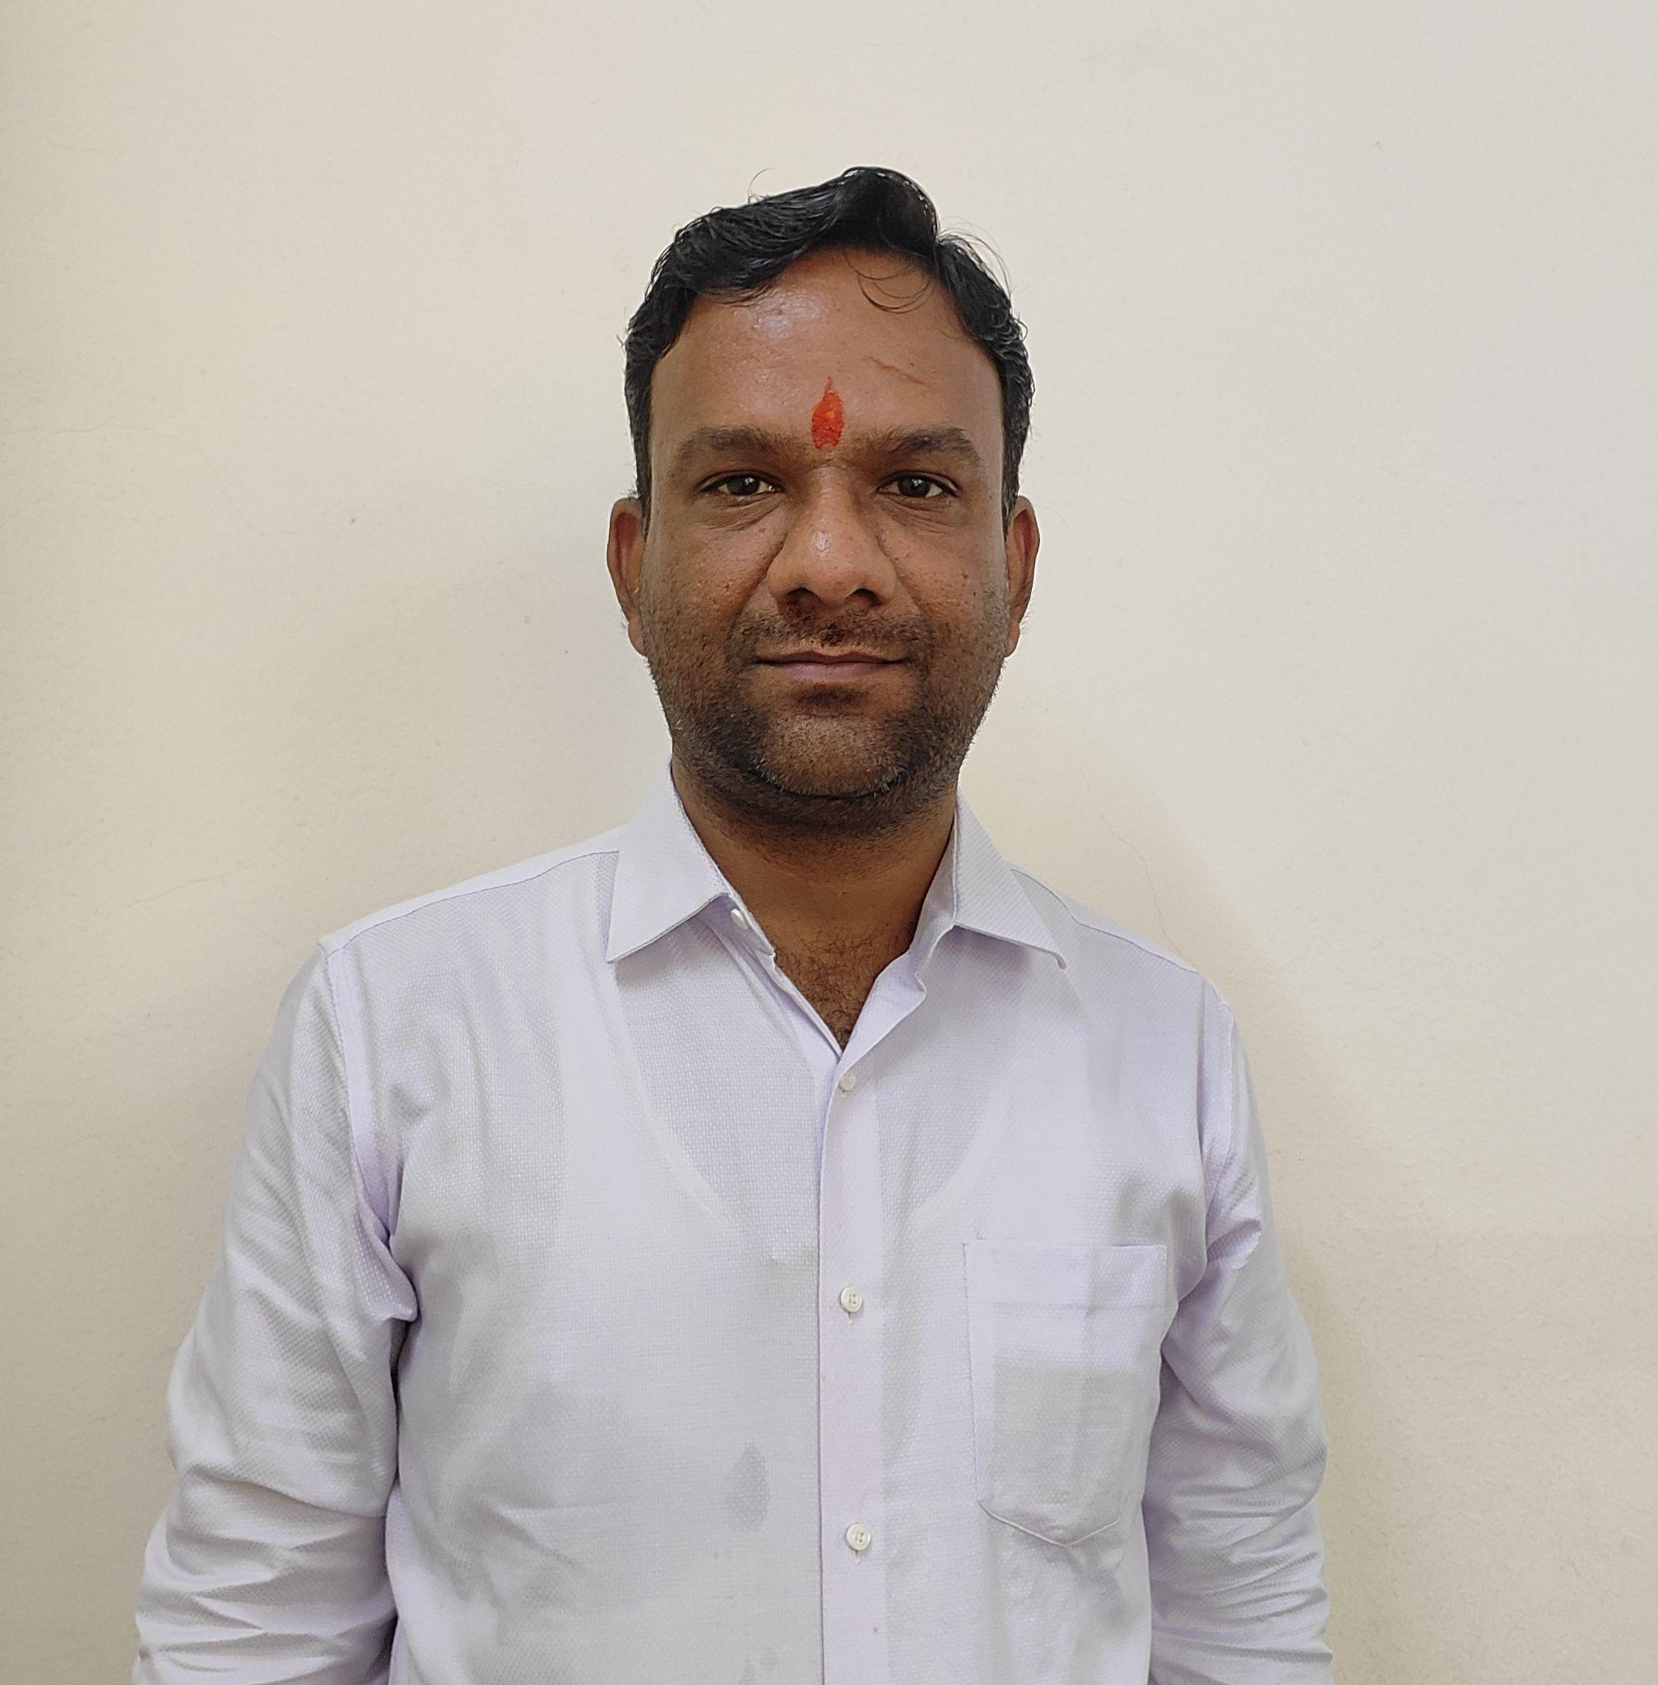
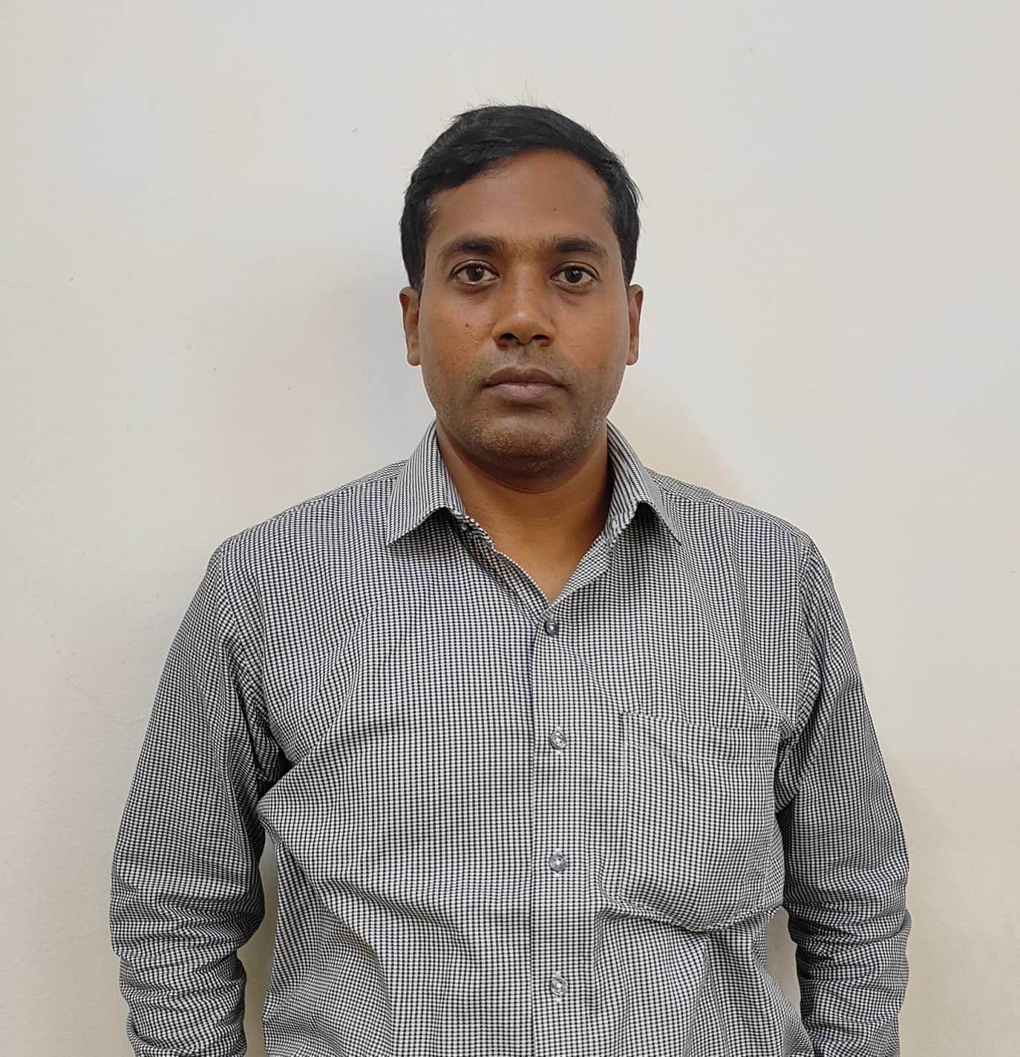
Mr. Mahendra Nandan Sharma accounts @jmlzsnagothane.in
Mr. Kamala Sankar
kamala.singh@jmlzsnagothane.in

Slide 18
Address by Principal
Ms. Lily Roy

Slide 19
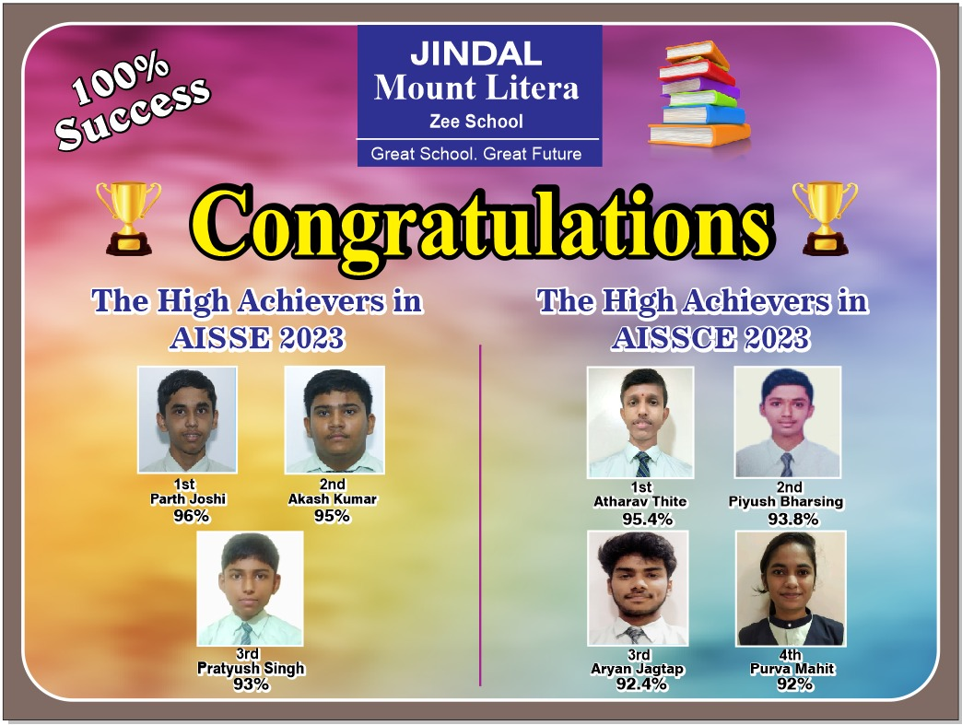
OUR ACHIEVIEVEMENTS

Slide 20
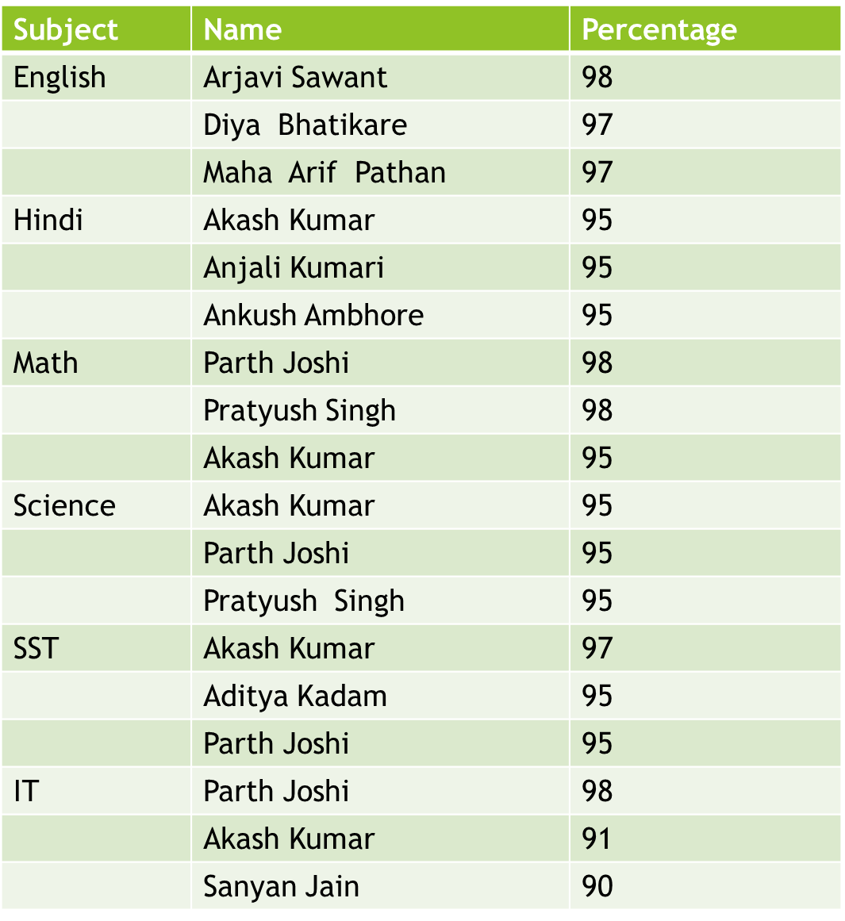
Result Analysis for Class X

Slide 21
Total students appeared | 56
Total students passed | 56
Result | 100%
RANK HOLDERS
1. Parth Joshi | 96%
2. Akash Kumar | 95%
3. Pratyush Singh | 93%
CBSE CLASS X RESULT

Slide 22
Subject | Name | Percentage
English | Aryan Jagtap | 97
 | Smriti Kumari | 97
 | Purva Mahit | 96
 | Sneha Jha | 96
Physics | Atharva Thite | 95
 | Aryan Jagtap | 94
 | Piyush Bharshing | 94
 | Sooraj Mohan | 94
Chemistry | Aryan Jagtap | 95
 | Atharva Thite | 95
 | Purva Mahit | 95
 | Sooraj Mohan | 94
Math/Biology | Athavale Thite | 95
 | Piyush Bharshing | 92
SST | Sneha Jha | 88
 | Atharva Thite | 99
 | Piyush Bharshing | 97
IT | Aryan Jagtap | 95
 | Purva Mahit | 95
Result Analysis for class XII

Slide 23
Total students appeared | 22
Total students passed | 22
Result | 100%
RANK HOLDERS
1. Athava Thite | 96%
2. Piyush Barshing | 94%
3. Purva Mahit | 92%
CBSE CLASS XII RESULT

Slide 24
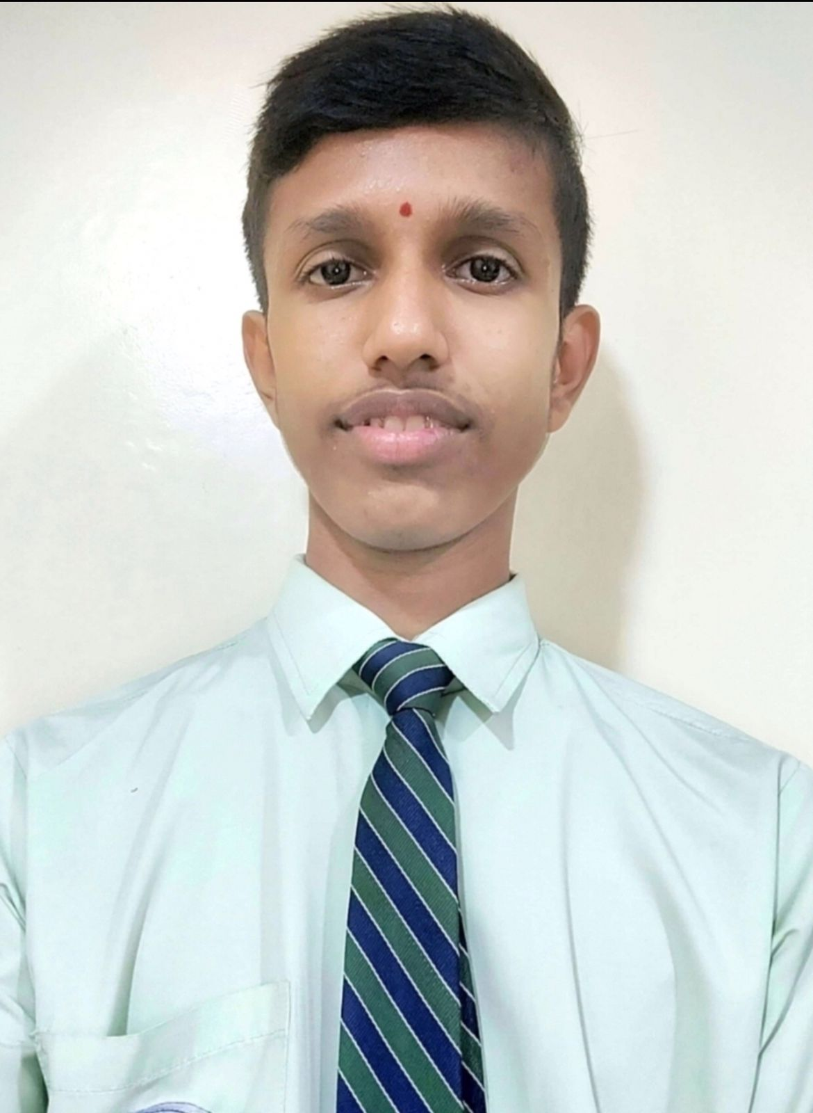
CONGRATULATIONS!!!
Master Atharva Thite of Class XII in MHT-CET 2023-24 for scoring 99.97%

Slide 25
1) Scholastic and Co- Scholastic pursuits:
By including Monday to Friday Scholastic education
Saturday exploring Co-Scholastic education
2) Trying to make our students “ Global citizen “ by practicing reading Newspaper.
3) Career Exploration workshops conducted by Expert Teachers.
4) Introduction of skilled based education
5) Suggestion Box
6) The amalgamation of ancient ( Gurukul Shiksha) and modern education.
7) Donation drive for an Orphanage
8) We will be providing training for teachers, students and parents more frequently.
9) Career Counselling
10) Personalized and tailored career counselling to individual student’s needs 11) Resource person in school.

Slide 26
Prominent focus is on What’s Right for the Child (WRFC)
Our Belief
EVERY CHILD
IS UNIQUE
JINDAL MOUNT LITERA ZEE SCHOOL
17

Slide 27
Our Aim
To develop an effective life long process of learning in the child, leading to holistic development.
Pedagogy:
School would mean a happy place…
JINDAL MOUNT LITERA ZEE SCHOOL
18

Slide 28
Pedagogy
Interactive iLLUME is derived from the 21st century skills; as stated by NAEYC (NATIONAL ASSOCIATION FOR EDUCATION OF YOUNG CHILDREN) 21st century education for preschool children are the following:
problem solving, critical thinking,
collaboration,
authentic learning,
appropriate use of technologies,
cross-disciplinary teaching.
JINDAL MOUNT LITERA ZEE SCHOOL
19

Slide 29
EMERGING STUDENT PROFILE (ESP)
Inquirer
Eco-conscious
Confident
Caring
Life-Long Learner
Healthy
ESP
Empathetic
Innovative
Leader
Logical
Responsible citizen
Digitally Responsible
JINDAL MOUNT LITERA ZEE SCHOOL
20

Slide 30
Life Ready Framework
JINDAL MOUNT LITERA ZEE SCHOOL
21

Slide 31
SKILL & PERSONALITY DEVELOPMENT
Attendance &Assembly (Yoga)
Free Play
Concept time
Math Time
Music & Movement
Language time
Reading time
Talk time
Library time
Sensory Time
Creative Time
Critical Thinking
Personality Development
Eco-Conscious
Outdoor Play
Tummy Time
Water Play
Science Time
Indoor Time
19 Sessions
JINDAL MOUNT LITERA ZEE SCHOOL
22

Slide 32
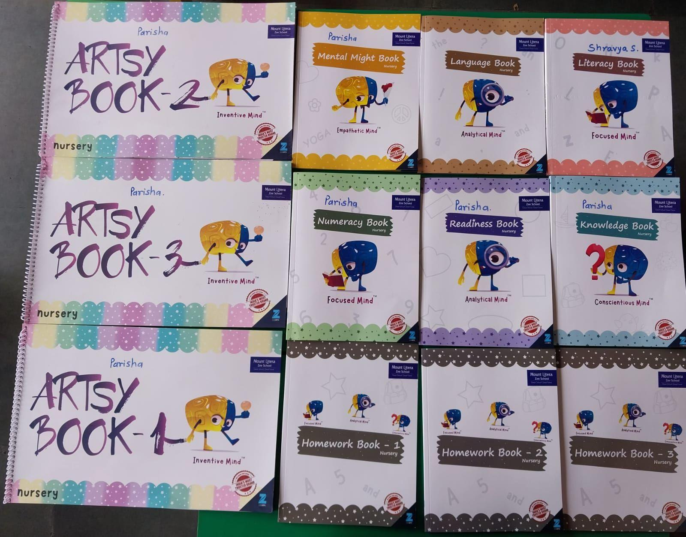
INTEGRATED
CHILD KIT
JINDAL MOUNT LITERA ZEE SCHOOL
23

Slide 33
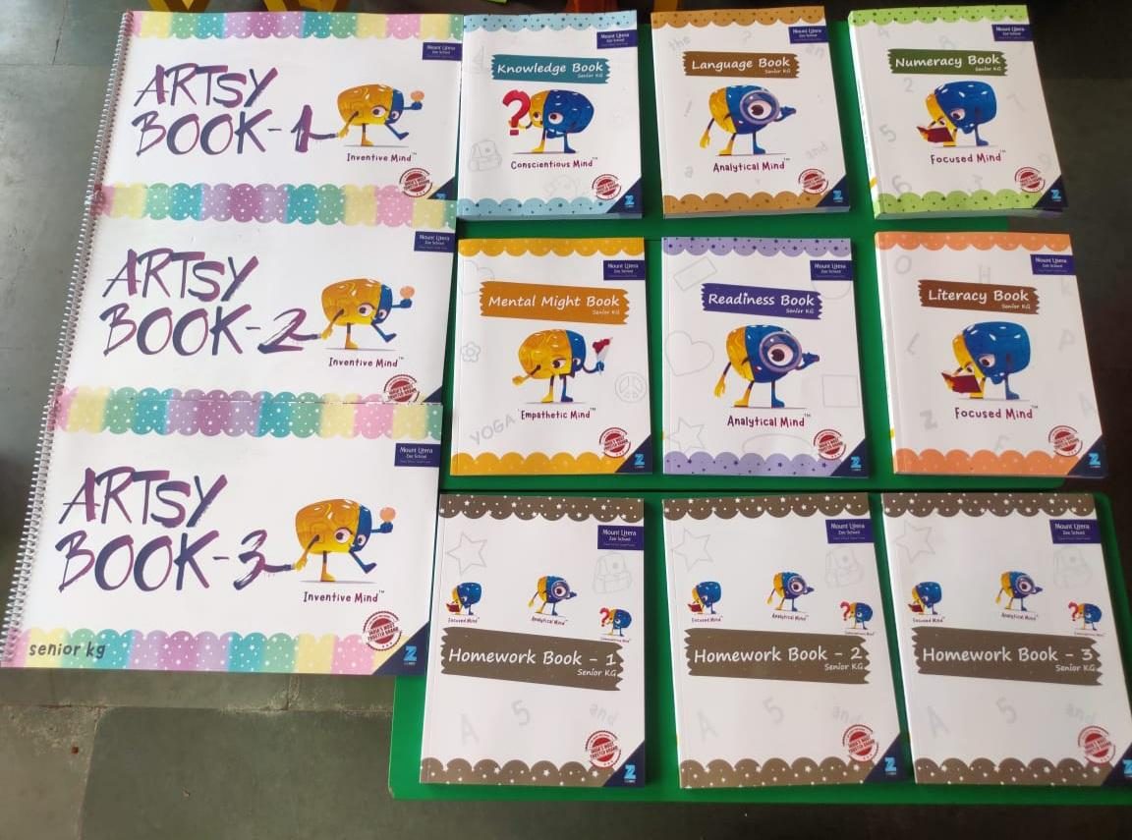
JINDAL MOUNT LITERA ZEE SCHOOL
24

Slide 34
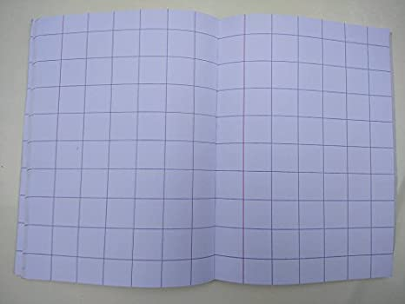
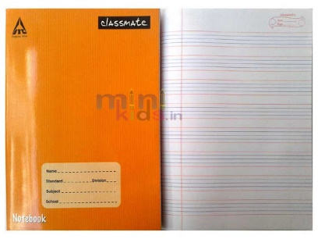
NOTEBOOKS ALLOTED FOR EACH CLASSES:
NURSERY- FOUR LINE BIG BOX (ENGLISH)
SQUARE NOTEBOOK (MATH)
JR.KG - FOUR LINE NOTEBOOK (ENGLISH)
FOUR LINE NOTEBOOK (EVS/GK)
SQUARE NOTEBOOK(MATH)
MY SKILL BOOK 1 ( HINDI)
SR.KG - FOUR LINE NOTEBOOK (ENGLISH)
FOUR LINE NOTEBOOK (EVS / GK)
SQUARE NOTEBOOK(MATH)
MY SKILL BOOK 2 ( HINDI)
FIVE LINE NOTEBOOK (HINDI)
25

Slide 35
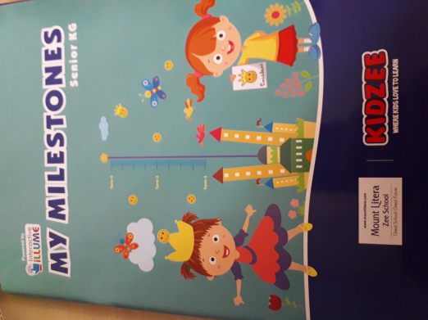
For this academic year according to new syllabus there are 3 Term in a year. 1st term will be held on last week of July , 2nd term will be held before Diwali vacation in the month of October and 3rd Term will be held in the month of March.
Evaluation of students milestone through class observation and class test:
Personal Health & Hygiene
Physical development
Fine & Gross motor skills
Creative development
Cognitive development
Language development
Personal, Social and Emotional development
Assessment
Guidelines
JINDAL MOUNT LITERA ZEE SCHOOL
26

Slide 36
PARENT ENGAGEMENTS
Settling In Period
Toilet Training
Events and Festival Celebrations
Field Trips
Nutritious Meals and Health Tips
Open and Close Door Policies
I CARE
JINDAL MOUNT LITERA ZEE SCHOOL
27

Slide 37
Culmination Activities
Culmination weeks are planned after completion of themes and sub-themes. They come usually at the end of four to six weeks.
The culmination week day is planned differently from the usual day. It aims to take a recap of the themes and concept covered with fun-filled methods. There are no worksheets planned for culmination.
Instead, creative activities and games are planned to recap the concept, language, and math topics completed in the prior weeks. At times, field trips are also planned in the culmination week.
Parents are also invited to see and understand the variety of things done in the given period. Activities which involve parents are also planned in the culmination. At times, parents are also invited to watch performances of children.
JINDAL MOUNT LITERA ZEE SCHOOL
28

Slide 38
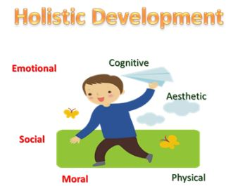
We strongly believe that Holistic Development of students is based on 4 pillars Student, Parent, Teacher and School.
To further strengthen the bond of all stake holders, we hereby, introduce the “Parent On Campus” policy.
In short, Everyday one parent present in the school campus before the start of the school till the end of the school.
This will not only enhance the trust between parents and school but will prove to be an important step towards fostering a relationship of confidence.
This is an effort to supplement and re-enforce our commitment to provide Safe and Secure Environment and to make parents as Partners in our endeavor of imparting Holistic Quality Education.
Parent On
Campus Policy
29

Slide 39
FEATURES OF PSED/PSDP PROGRAM
It is a Physical Skill Development program.
The program has been designed for the Pre-Schoolers.
Objectives:
Enable the children to have better control and coordination of bodily functions.
To enhance fine and gross motor skills
To ensure agility and healthy habits amongst the pupils
About the Program
It is a 10 week program.
Covers appropriate milestones .
Structured to cover domains of Physical development.
Module is in the form guidelines to parents/facilitators and a demonstrative video.
Content is Facilitator and Parent Friendly and Age appropriate.
JINDAL MOUNT LITERA ZEE SCHOOL
31

Slide 40
JINDAL MOUNT LITERA ZEE SCHOOL
32

Slide 41
JINDAL MOUNT LITERA ZEE SCHOOL
33

Slide 42
The school will not tolerate inappropriate behaviour by students such as bullying or ragging of any kind, overt display of affection between students, theft, forgery, borrowing without permission of the owner, improper care of the property of others and using obscene or vulgar language.
JINDAL MOUNT LITERA ZEE SCHOOL
34

Slide 43
INTRODUCTION TO CHILD’S RIGHT
The United Nations Convention on the Rights of the Child (CRC) defined four basic child rights of survival, development, protection and participation.
The CRC gives the following basic rights to all the children in the world without any discrimination:
Right to Survival
Right to Protection
Right to Participation
Right to Development
JINDAL MOUNT LITERA ZEE SCHOOL
35

Slide 44
ABOUT-CHILD ABUSE
What is Child Abuse?
In 1999, the WHO Consultation on Child Abuse Prevention compared definitions of abuse from 58 countries and drafted the following definition:
‘‘Child abuse or maltreatment constitutes all forms of physical and/or emotional ill-treatment, sexual abuse, neglect or negligent treatment or commercial or other exploitation, resulting in actual or potential harm to the child’s health, survival, development or dignity in the context of a relationship of responsibility, trust or power.’’
JINDAL MOUNT LITERA ZEE SCHOOL
36

Slide 45
WAYS TO DEAL WITH CHILD ABUSE
Be open and understanding.
Believe the child.
Let the child talk as much as he or she wishes.
Understand that the child is probably having mixed feelings.
Explain what you will do next to help them.
Never discipline the child when your anger is out of control.
Never leave the child unattended.
Teach children the difference between “good touch”, “bad touch”, and “confusing touch”.
Be aware of any changes in children’s behavior or attitude, and inquire into it.
JINDAL MOUNT LITERA ZEE SCHOOL
37

Slide 46
WAYS TO DEAL WITH CHILD ABUSE
When a child tells you he or she doesn’t want to be with someone, this could be a red flag. Listen to them and believe what they say.
Teach children what to do if they are separated from their parents/ known person on an outing.
Teach children the correct names of their private body parts.
Be alert for any talk that reveals premature sexual understanding.
Pay attention when someone shows greater than normal interest in any child.
Make certain you release a child only to someone who has been officially designated.
As per POCSO Act 2012, reporting cases of child sexual abuse to law enforcement authorities is mandatory.
Failure to report a suspicion of child abuse is an offence under the Act.
JINDAL MOUNT LITERA ZEE SCHOOL
38

Slide 47
SCHOOL POLICIES
JINDAL MOUNT LITERA ZEE SCHOOL
39

Slide 48
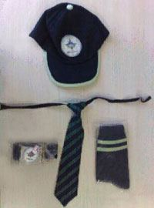
UNIFORM
For Boys
Green colour T-shirt
Navy blue colour half pant
For Girls
Green colour T-shirt
Navy blue colour skirt
Common Uniform
Belt, and Socks are to be worn by both Boy and Girl students.
Make sure your child wears the ID card everyday.
JINDAL MOUNT LITERA ZEE SCHOOL
40

Slide 49
TRANSPORT POLICY
Student should arrive at assigned bus stop five minutes ahead of the bus. The driver cannot wait for you, as it may create traffic problems.
The bus attendant has the authority to assign seats.
Parents are not allowed to interfere about their children's seats because teachers have given the right to arrange children's sitting and they can rotate kids on a monthly or weekly basis.
Students are required to ride their assigned bus, unless they have written approval from the transport department.
In some cases if parents come & pickup their kid then prior notice must be given to teacher regarding the take away.
If your are a walker & because of some reason if you cannot come to school for takeaway your kid than you must handover written letter to the person whom you trust and want to handover your kid. Otherwise we will not allowed your kid to go with any one if you call us and insist us.
Refrain from talking to the driver expect in an emergency.
Parents should also support policies of the school and transport department.
JINDAL MOUNT LITERA ZEE SCHOOL
41

Slide 50
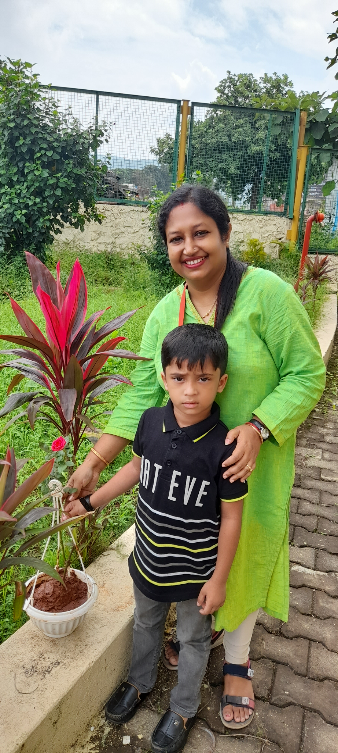
Birthday Policy
The Students can bring any small Chocolate of value Rs.1 or Rs.2.
No Birthday Parties will be held in School
No Birthday gifts or return gifts will be exchanged with students or educators.
You can send your child in party dress.
Children will bring a sapling for plantation
42

Slide 51
School Timings
Monday to Saturday: 9:10 a.m.– 12:30 p.m. (Offline)
All Saturdays & Sunday will be holiday for students. (Offline)
School Office Timing on all working days 9:00 a.m. to 5:00 p.m.
Timing during Long vacation 9:30 a.m. to 3:30 p.m.
School Office will be open on all Saturday except Gazette Holidays.
For any query or discussion you can contact the teacher, Coordinator between 1.00 p.m. to 4.00 p.m. from Monday to Saturday.
43

Slide 52
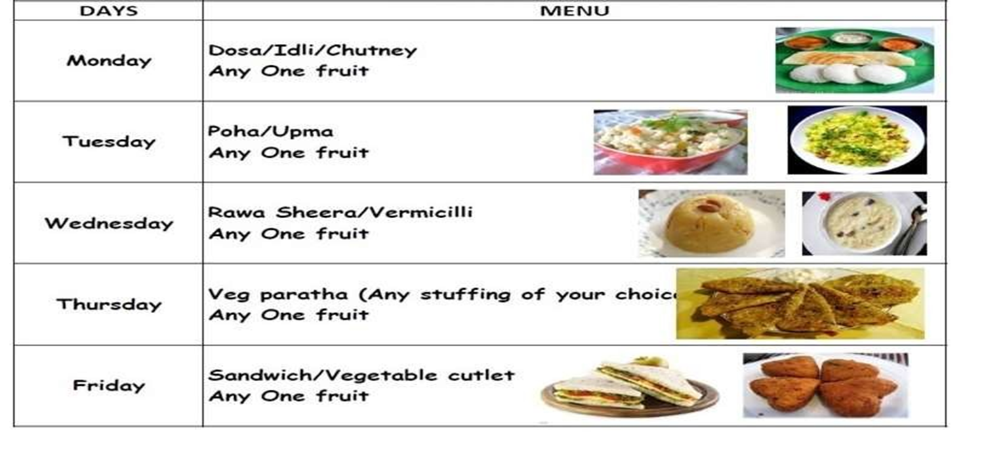
Food Menu
In case your child is allergic to suggested menu, you can send suitable snack in their tiffin.
Non- veg food should not be send in the tiffin box to school.
JINDAL MOUNT LITERA ZEE SCHOOL
44

Slide 53
April- All about me
June- Save Nature
July- Blossoms
August- Sharing Is Caring
September- Fairy Island
October- Festive Vibes
November- Sugar Candies
December- Best Out Of Waste
January- Around The World
February- Play & Learn
Monthly Assembly
Theme
2023-24
JINDAL MOUNT LITERA ZEE SCHOOL
45

Slide 54
Pre-Primary
Time Table
Monday to Friday
(offline)
JINDAL MOUNT LITERA ZEE SCHOOL
46

Slide 55
Time Table - NURSERY Class Nursery B
Periods | Monday | Tuesday | Wednesday | Thursday | Friday
Period 1 19:45 - 10:30 | English | English | English | Maths | Maths
Break Time 10:30 - 10:50
Period 2 10:50 - 11:20 | General Knowledge | General Knowledge | EVS | EVS | Activity
Period 3 11:20 - 11:40 | Hindi | Hindi | Hindi | Hindi | Hindi
Period 4 11:40 - 12:10 | Free Play (O) | Dance | Free Play | Music | Free Play (I)
Period 5 12:10 - 12:25 | Rhymes/Story | Rhymes/Story | Rhymes/Story | Rhymes/Story | Rhymes/Story
NURSEY
JINDAL MOUNT LITERA ZEE SCHOOL
47

Slide 56
Time Table - JUNIOR KG Class Junior A
Periods | Monday | Tuesday | Wednesday | Thursday | Friday
Period 9:45 - 10:30 | English | English | English | Maths | Maths
Break Time 10:30 - 10:50
Period 10:50 - 11:20 | General Knowledge | General Knowledge | EVS | EVS | Activity
Period 11:20 - 11:40 | Hindi | Hindi | Hindi | Hindi | Hindi
Period 11:40 - 12:10 | Dance | Free Play (O) | Music | Free Play (I) | Free Play (O)
Period 12:10 - 12:25 | Rhymes/Story | Rhymes/Story | Rhymes/Story | Rhymes/Story | Rhymes/Story
JR.KG
JINDAL MOUNT LITERA ZEE SCHOOL
48

Slide 57
Period | Monday | Tuesday | Wednesday | Thursday | Friday | Saturday
Period 1 09:45:00 - 10:30:00 | English SENIOR KG | English SENIOR KG - | English SENIOR KG - | Mathematics SENIOR KG - | Mathematics | SENIOR KG
Break Time 10:30:00 - 10:50:00 | Break Time | Break Time | Break Time | Break Time | Break Time | Break Time
Period 2 10:50:00 - 11:20:00 | General Knowledge SENIOR KG | General Knowledge SENIOR KG | EVS SENIOR KG | EVS SENIOR KG | Activity SENIOR KG
Period 3 11:20:00 - 11:40:00 | Hindi SENIOR KG | Hindi SENIOR KG | Hindi SENIOR KG | Hindi SENIOR KG | Hindi SENIOR KG
Period 4 11:40:00 - 12:10:00 | Free Play (O) SENIOR KG | Free Play (I) SENIOR KG | Free Play (O) SENIOR KG | Free Play (I) SENIOR KG | Music/Dance SENIOR KG
Period 5 12:10:00 - 12:25:00 | Rhymes/Story SENIOR KG | Rhymes/Story SENIOR KG | Rhymes/Story SENIOR KG | Rhymes/Story SENIOR KG | Rhymes/Story SENIOR KG
SR.KG
JINDAL MOUNT LITERA ZEE SCHOOL
49

Slide 58
DAILY CLASS TIMETABLE FOR BOOKS
MONDAY | TUESDAY | WEDNESDAY | THURSDAY | FRIDAY
ENGLISH | ENGLISH | ENGLISH | MATH | MATH
GK | GK | EVS | EVS | ACTIVITY
HINDI | HINDI | HINDI | HINDI | HINDI
JINDAL MOUNT LITERA ZEE SCHOOL
50

Slide 59
Subjects taught by the Mother Educator
Subjects that will be taught by a mother Educator :
English
Mathematics
General Knowledge ( G. K.)
EVS
Hindi
JINDAL MOUNT LITERA ZEE SCHOOL
51

Slide 60
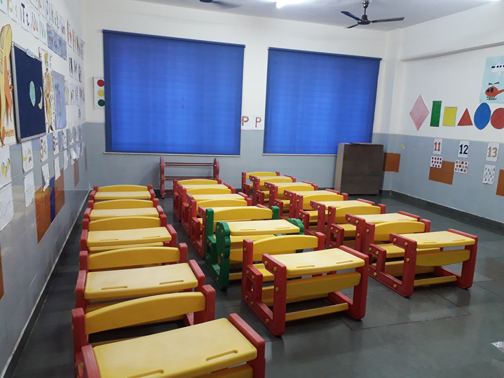
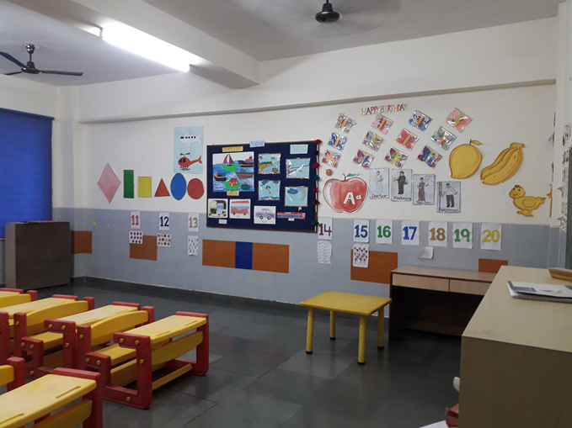
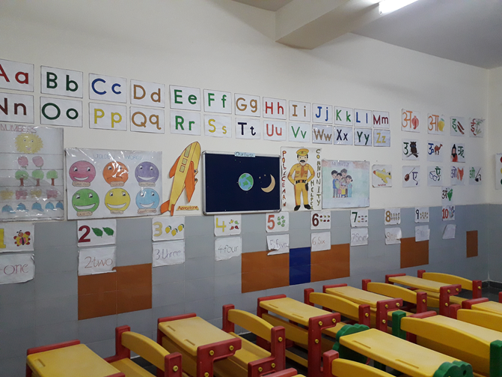
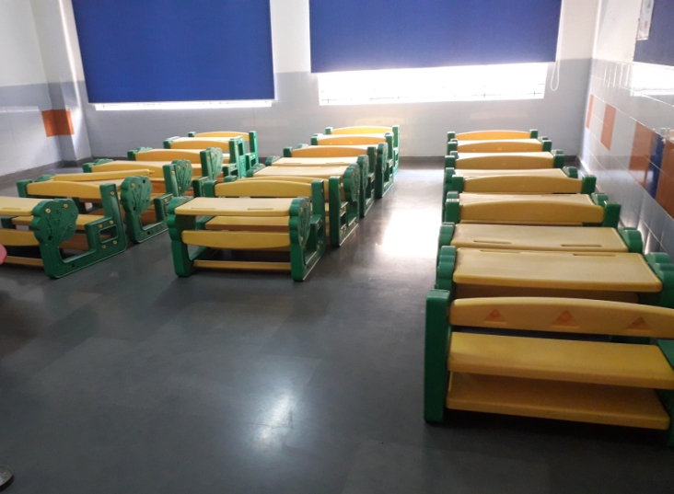
Our Classroom
JINDAL MOUNT LITERA ZEE SCHOOL
52

Slide 61
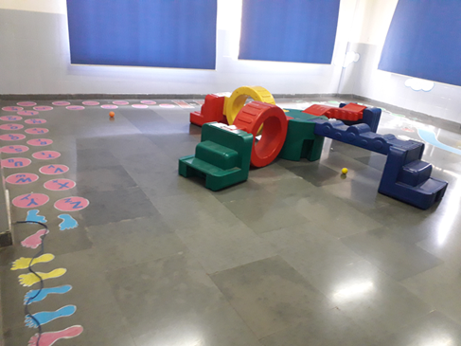
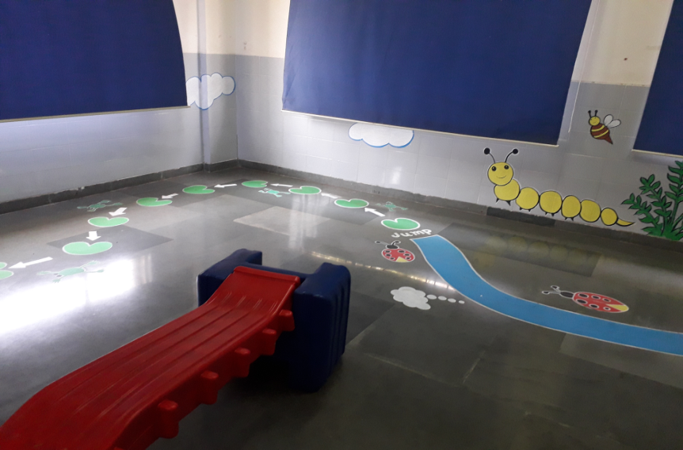
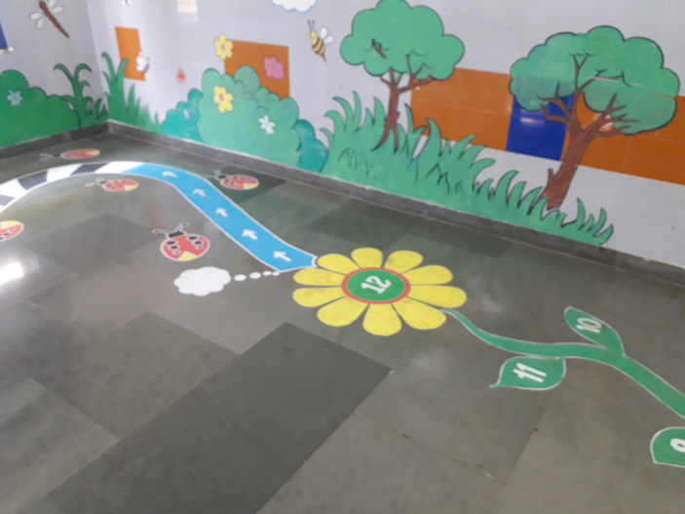
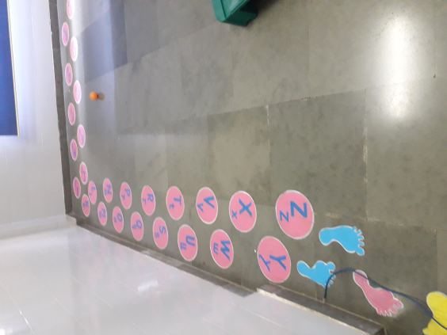
Illume
Room
JINDAL MOUNT LITERA ZEE SCHOOL
53

Slide 62
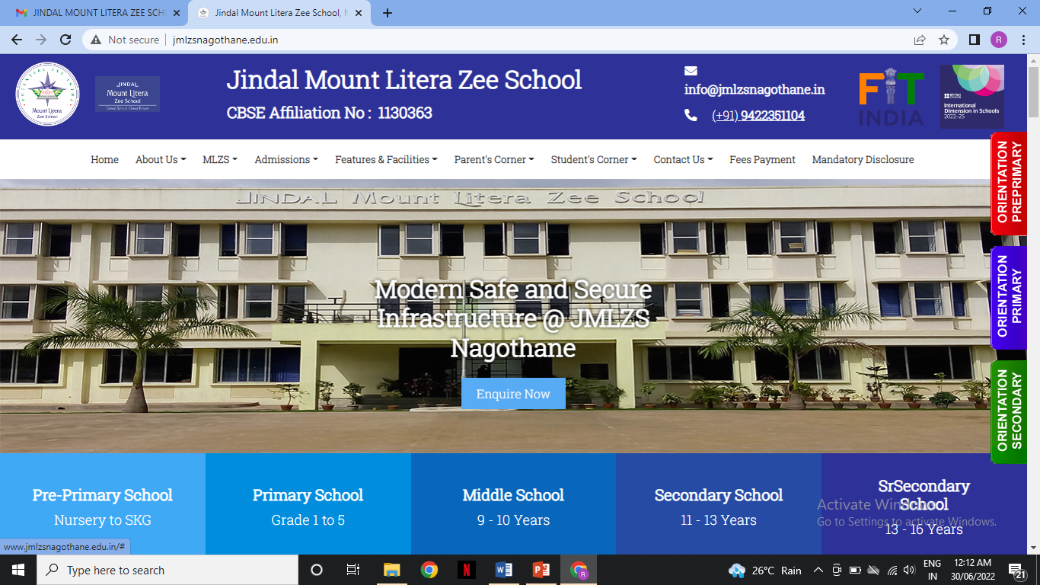
60

Slide 63
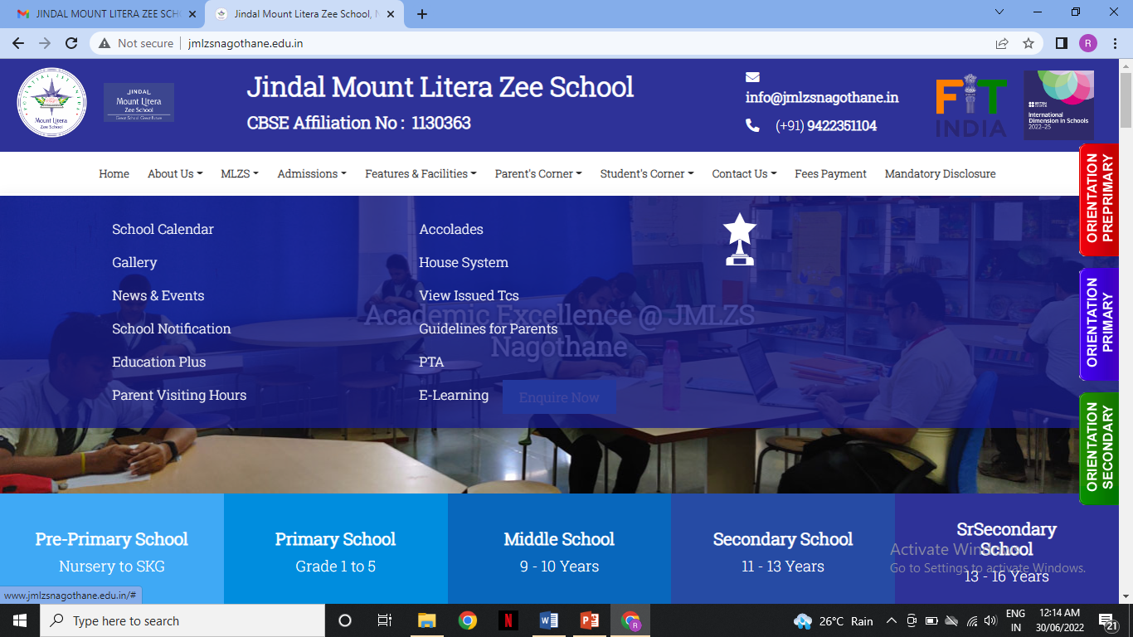
61

Slide 64
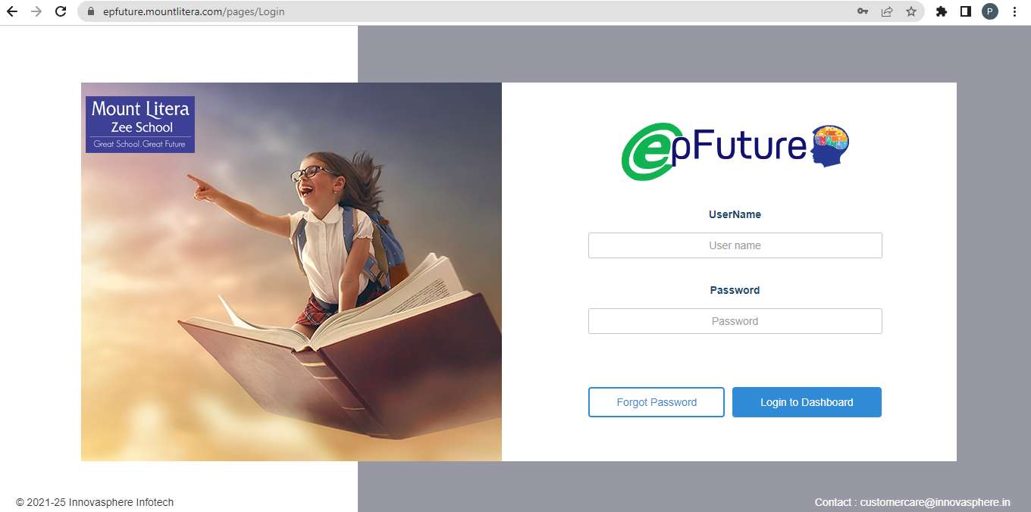
JINDAL MOUNT LITERA ZEE SCHOOL
59

Slide 65
INTERNATIONAL DIMENSION IN SCHOOL (IDS)
IDS-The British Council International Dimension In School is a benchmarking scheme that accredits schools as having an outstanding level of support for:
Nurturing global citizenship in young people
Enriching teaching and learning
IDS was introduced in India in the year 2003 and nearly 1300 schools across the country have joined this exciting journey since then.
JINDAL MOUNT LITERA ZEE SCHOOL
62

Slide 66
Various Collaborative and Inhouse activities were conducted to promote international topics of education.
Through these activities students develop awareness about international issues and think globally and out of the box.
It also creates opportunities to establish link with schools from other parts of the world.
JINDAL MOUNT LITERA ZEE SCHOOL
63

Slide 67
Hierarchy to be followed for Feedback
CLASS TEACHER
CO ORDINATOR
PRINCIPAL
RSD
66

Slide 68
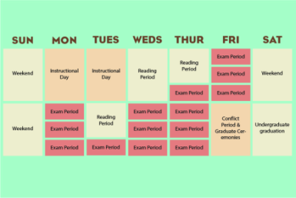
Students Handbook / Almanac- will provide valuable information regarding School procedures.
Academic Calendar- will be uploaded on the school website or provided in paper format, to parents and will focus on information regarding your child’s upcoming activities & holidays. http://www.jmlzsnagothane.edu.in/Calendar
Web Site http://www.jmlzsnagothane.edu.in/- The school website will have information regarding the and will be updated on a consistent basis.
https://www.facebook.com/jmlzsnagothane
E-mail:- mlzsnagothane@gmail.com
Phone calls:-02194-238845, 9422351104
Circulars:- Written circulars will be sent to the parents whenever required. It will be available on school website.
School management system:- It is available on school website.
Parent Communication
JINDAL MOUNT LITERA ZEE SCHOOL
67

Slide 69
Whom To Contact
Lost and found items are kept in the School’s Back Office. Any valuable item or cash found by students should be deposited at the Front Office. Students are advised to clearly write their name and class on all items brought to the school.
Email : mlzsnagothane@gmail.com
Phone:+91 9422351104
JINDAL MOUNT LITERA ZEE SCHOOL
68

Slide 70
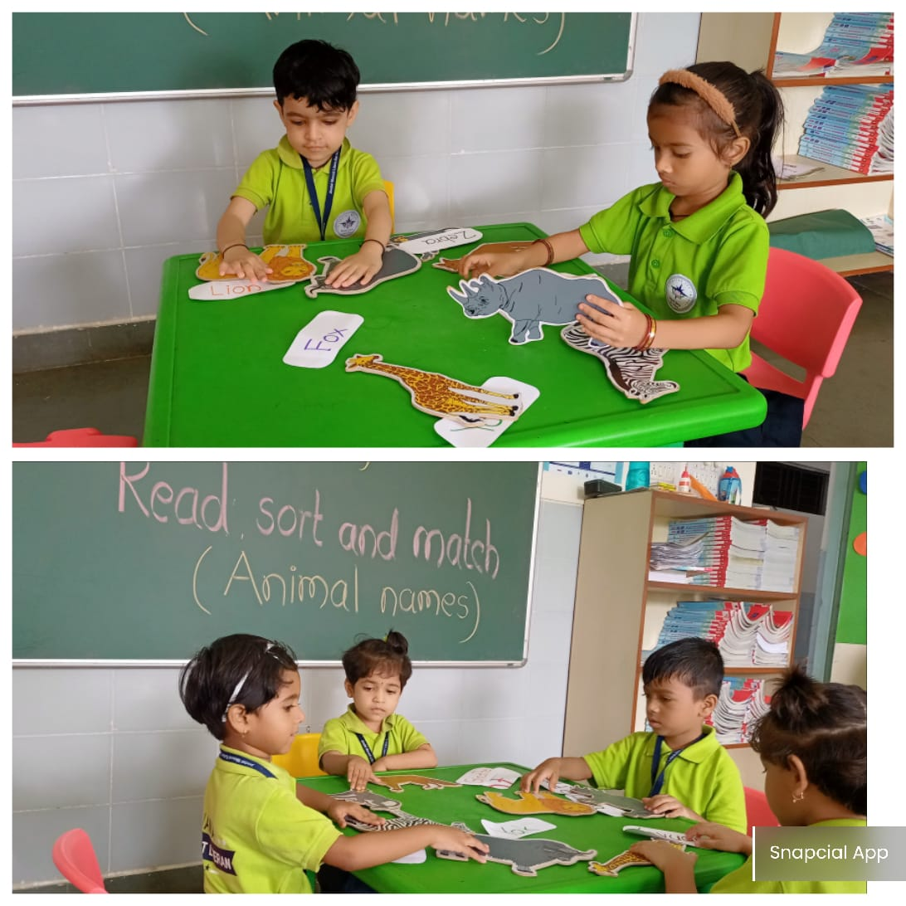
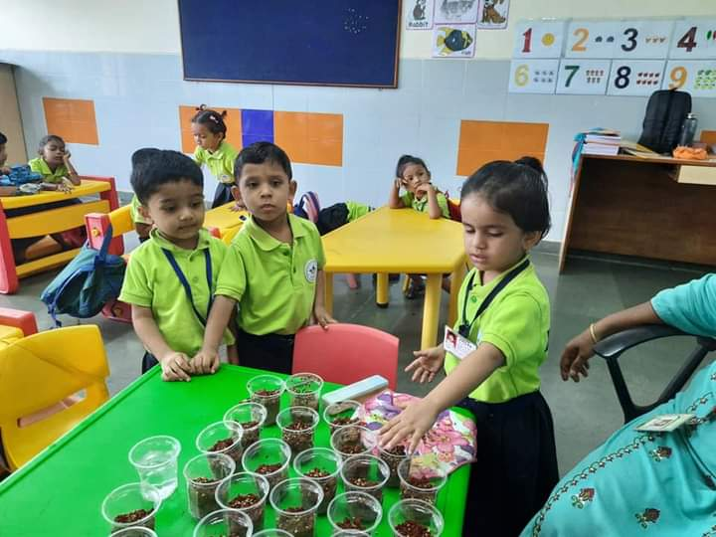
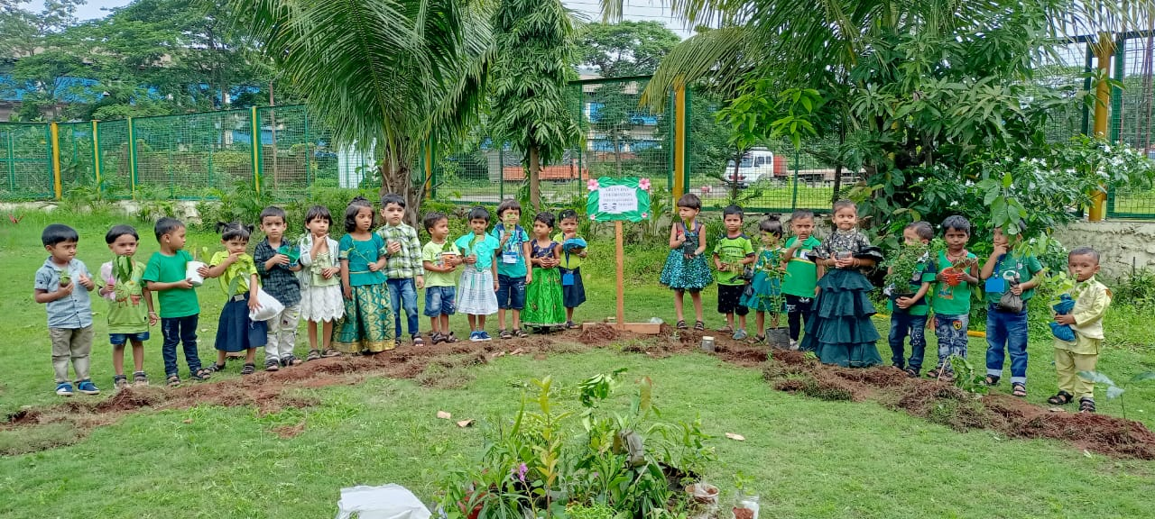
Germination of Seed Activity
Planting Trees Activity
Read sort & match
Co-scholastic Activities
2022-23

Slide 71
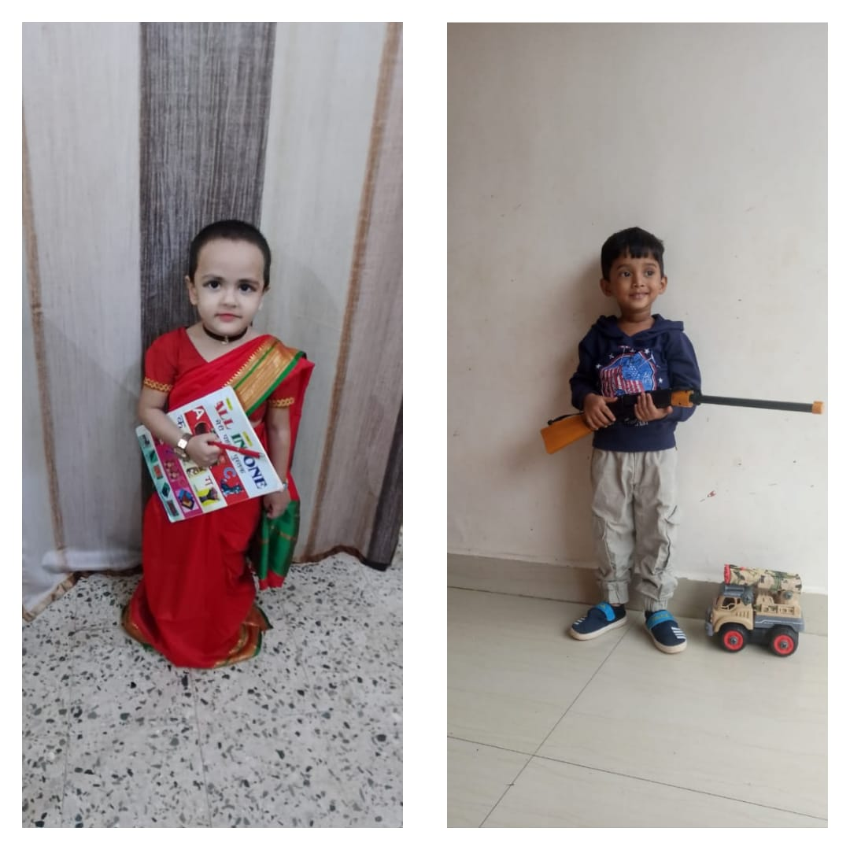
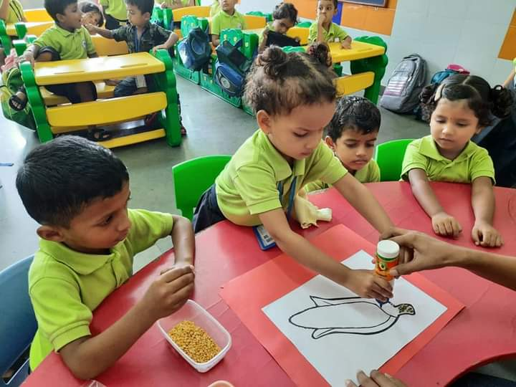
Fancy Dress on community helper
Corn Making
Activity
Talk show
Activity
Co-scholastic Activities
2022-23

Slide 72
Diya making
Activity
Paper bag Making
Activity
Card Making Activity
JINDAL MOUNT LITERA ZEE SCHOOL

Slide 73
Summer camp Activity
Cut & Paste Activity
Field Trip

Slide 74
Janmashtami Celebration
Grand Parents Day Celebration
Celebrations 2022-21
JINDAL MOUNT LITERA ZEE SCHOOL

Slide 75
Children Day Celebration
Purple Day Celebration
Orange Day Celebration

Slide 76
Independence Day Celebration
Annual Sports Day
76

Slide 77
THANK YOU
JINDAL MOUNT LITERA ZEE SCHOOL
78

